Slide 1
AMAZON SALES
DATA ANALYSIS REPORT
Sanjudevi Gupta

Slide 2
Problem Statement
Objective
Benefits
Help out to make better business decisions.
Help analyze customer trends and satisfaction, which can lead to new and better products and services.
Gives better insight of customers base.
Helps in easy flow for managing resources.
Sales management has gained importance to meet increasing competition and the need
for improved methods of distribution to reduce cost and to increase profits. Sales
management today is the most important function in a commercial and business
enterprise.
Develop a Report by Extracting-Transforming-Loading of data which contains Sales trend with respect to Year, Month, Quarter and find Some relationships through data to understand and Analyze the Facts.

Slide 3
Quick Insight
﻿A quick insight for 2017 | 2018 | 2019 amazon sales.
513k
Unit sold
2857K
Cost
75.45M
Total Profit
12
Products
137.35M
Total Revenue

Slide 4
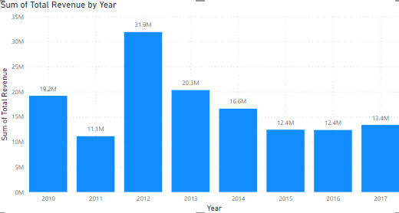
Total Sales for all the Year’s
﻿2012 had the highest Revenue at 31.9M, followed by 2013 at 20.3M and 2014 at 16.6M﻿

Slide 5
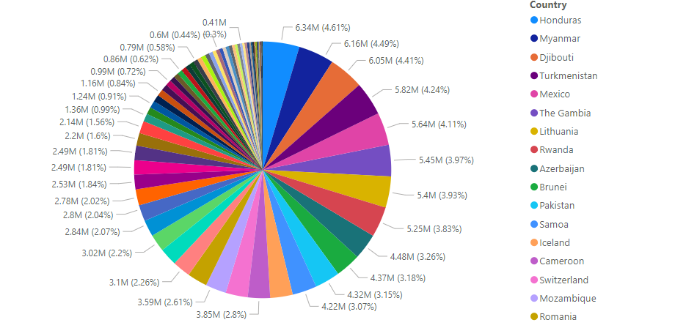
Revenue Categorized By Countries
Honduras has the highest revenue which is 6.34 M

Slide 6
Top 5 Products
Cosmetic is the highest selling product with revenue approx. 28k

Slide 7
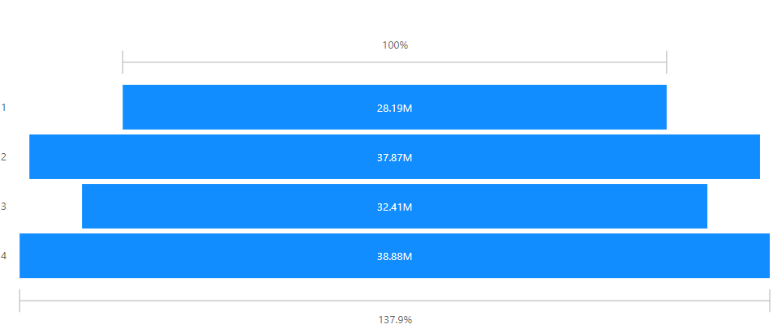
Quarter wise revenue
The revenue is high in between of October to December

Slide 8
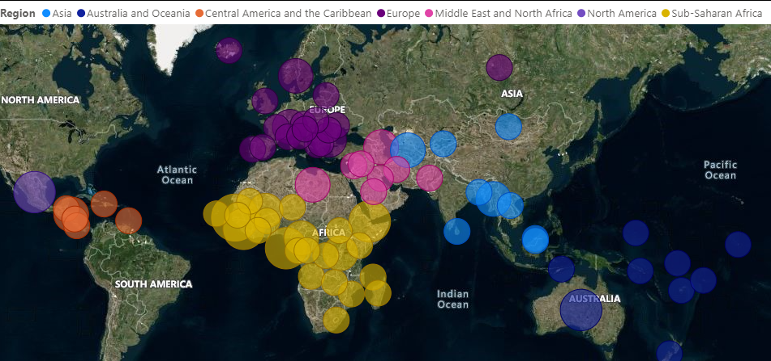
Countries wise sales
.

Slide 9
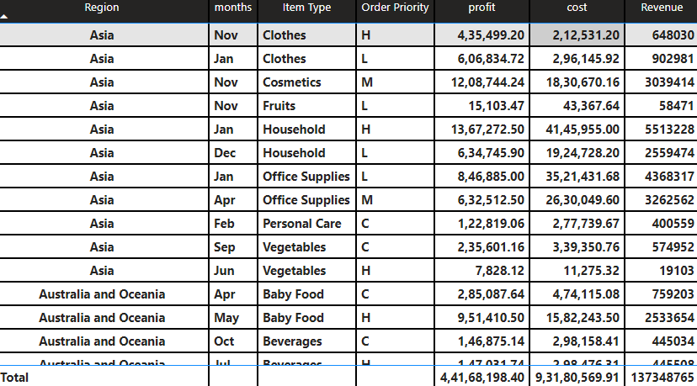
Overall table
﻿It’s show the Region , months , item type ,order priority , cost , profit , revenue .

Slide 10
Conclusion
2012 had the highest Revenue at 31.9M, followed by 2013 at 20.3M and 2014 at 16.6M
2. Honduras has the highest revenue which is 6.34 M
3. Cosmetic is the highest selling product with revenue approx. 28k
4. The revenue is high in between of October to December

